Slide 1
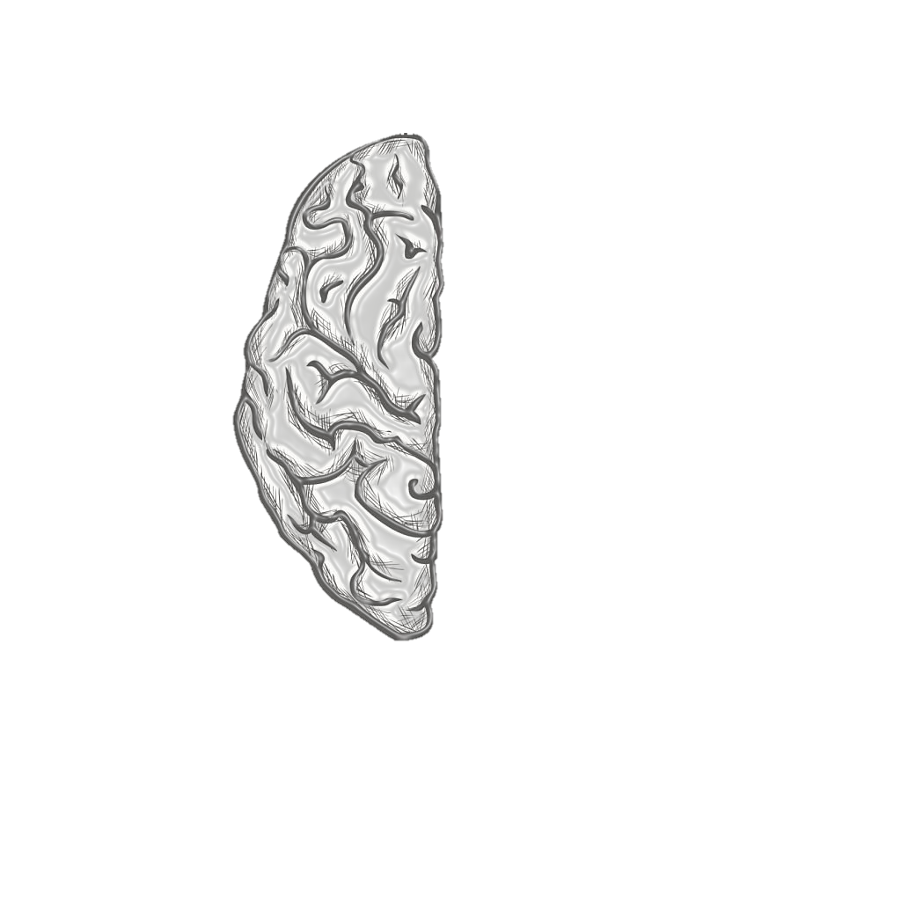
Dementia Detection
Early Stage
Using Machine Learning

Slide 2











D
F
G
C
A
B
E
CONTENT
CONCLUSION
&
FUTURE
LITERATURE
REVIEW
INTRODUCTION
MOTIVATION
METHODOLOGY
RESULTS
REFERENCES
3 layers model
1 model is based on audio dataset
Second is questionnaire
Third is final layer requiring clinical data.
Dementia overview
Early detection with Machine learning
Limitations
Our approach
Dementia Impact
Diagnosis Challenge
ML as solution
Easy Access to Diagnosis tools
References of Relevant papers
Table of relevant images
References for Dataset
How to proceed after Diagnosis.
Building audio assistance for 1st layer.
Implementing DL.
Research work key points
Limitations
Take away from every Research work
Compared Accuracy of different ML algorithms
SVM performed the best.
With KNN being Worst

Slide 3
D
F
A
B
C
E
G
CONTENT
CONCLUSION
&
FUTURE
INTRODUCTION
MOTIVATION
LITERATURE
REVIEW
METHODOLOGY
RESULTS
REFERENCES
Dementia overview
Early detection with Machine learning
Limitations
Our approach
Dementia Impact
Diagnosis Challenge
ML as solution
Easy Access to Diagnosis tools
3 layers model
1 model is based on audio dataset
Second is questionnaire
Third is final layer requiring clinical data.
References of Relevant papers
Table of relevant images
References for Dataset
Research work key points
Limitations
Take away from every Research work
Compared Accuracy of different ML algorithms
SVM performed the best.
With KNN being Worst
How to proceed after Diagnosis.
Building audio assistance for 1st layer.
Implementing DL.

Slide 4
A
C
D
F
G
B
E
CONTENT
CONCLUSION
&
FUTURE
INTRODUCTION
LITERATURE
REVIEW
MOTIVATION
METHODOLOGY
RESULTS
REFERENCES
Dementia overview
Early detection with Machine learning
Limitations
Our approach
3 layers model
1 model is based on audio dataset
Second is questionnaire
Third is final layer requiring clinical data.
Dementia Impact
Diagnosis Challenge
ML as solution
Easy Access to Diagnosis tools
Research work key points
Limitations
Take away from every Research work
Compared Accuracy of different ML algorithms
SVM performed the best.
With KNN being Worst
How to proceed after Diagnosis.
Building audio assistance for 1st layer.
Implementing DL.
References of Relevant papers
Table of relevant images
References for Dataset

Slide 5
INTRODUCTION
INTRODUCTION
INTRODUCTION
INTRODUCTION
INTRODUCTION

Slide 6
INTRODUCTION
INTRODUCTION
INTRODUCTION
INTRODUCTION
INTRODUCTION

Slide 7
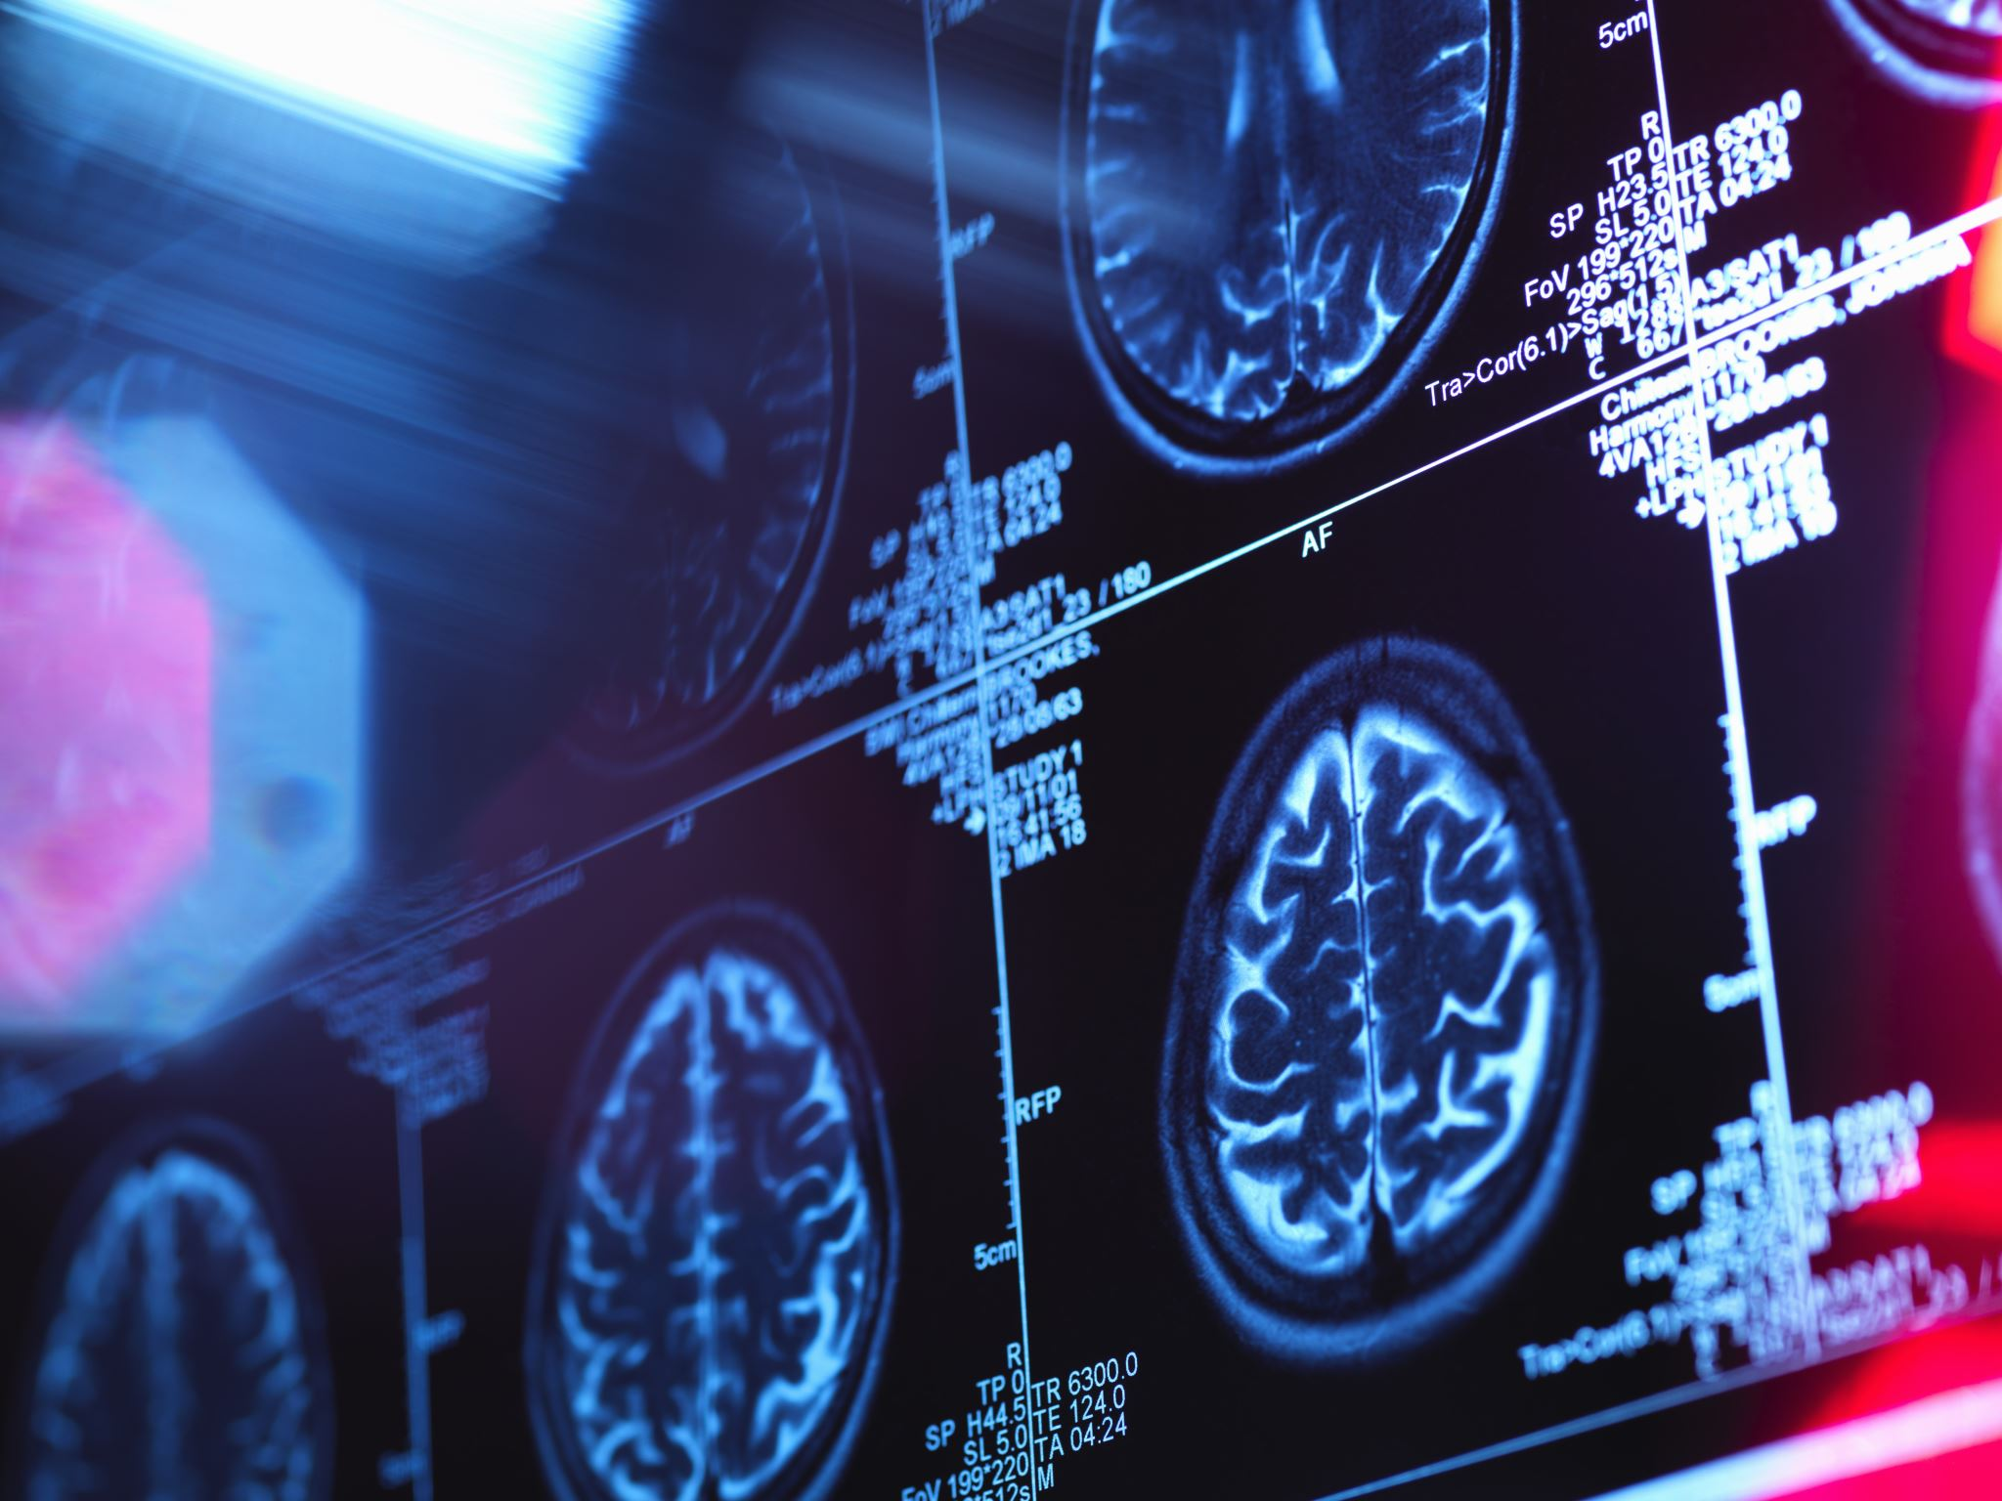
DEMENTIA
Dementia Overview: Dementia, a degenerative brain disorder, hampers cognitive functions due to conditions like Alzheimer's disease, vascular issues, or Lewy body deposits, causing a gradual decline in mental abilities.
Early Detection with Machine Learning: Machine learning analyzes cognitive patterns and behavioral data, enabling timely intervention and personalized care by identifying subtle signs of dementia.
Limitation in Detection Timing: Delayed testing, observed when noticeable changes prompt assessments, often means dementia significantly affects individuals before diagnosis. Early detection methods are crucial for proactive identification before symptoms become evident.
Our Approach: Utilizing audio analysis and cognitive questionnaires, our three-stage approach recommends patients for further evaluation, ensuring cost-effective and timely identification of dementia cases through proactive measures.

Slide 8
MOTIVATION
MOTIVATION
MOTIVATION
MOTIVATION
MOTIVATION

Slide 9
MOTIVATION
MOTIVATION
MOTIVATION
MOTIVATION
MOTIVATION

Slide 10
MOTIVATION
Dementia profoundly affects not just individuals but also their families and healthcare systems, creating emotional and practical challenges.
Existing diagnostic tests often struggle to predict dementia promptly, leading to misdiagnoses and increased strain on families dealing with the condition.
Low-income countries, grappling with resource shortages, struggle to provide adequate healthcare for a population vulnerable to dementia.
Our project strives to democratize access to affordable and accurate ML-powered diagnostic tools, breaking down financial barriers and ensuring timely interventions for all individuals.

Slide 11
LITERATURE REVIEW
LITERATURE REVIEW
LITERATURE REVIEW
LITERATURE REVIEW
LITERATURE REVIEW

Slide 12
LITERATURE REVIEW
LITERATURE REVIEW
LITERATURE REVIEW
LITERATURE REVIEW
LITERATURE REVIEW

Slide 13
PAPER 1
NAME | KEY POINTS | SHORTCOMINGS
Early Diagnosis of Dementia from Clinical Data by Machine Learning Techniques | Two-level hierarchical model offers a fast, cost effective and reliable way to diagnose Dementia. At first level, MMSE-KC score examines the patient and categorizes them into Normal and Cognitive decline. At second level, CERAD-K is `conducted on people diagnosed as cognitive declined which further categorizes them into MCI and Dementia. | The study relies on specific datasets, potentially limiting its generalizability to diverse populations. Features like lifestyle, disease information has not been taken into consideration and has been put as future research.
Take away: One of few paper that has taken Cost factor into consideration.
Our proposed model is based on this.

Slide 14
PAPER 2
NAME | KEY POINTS | SHORTCOMINGS
Performance of Machine Learning Algorithms for Predicting Progression to Dementia in Memory Clinic Patients | Comparison of different Machine Learning models with existing models . Machine learning algorithms were superior in their ability to predict incident dementia within 2 years compared with 2 existing predictive models. Machine learning algorithms required only 6 variables to reach an accuracy of at least 90%. | Models used in the study were developed on different populations. Some variables in these models did not have direct equivalents in the UDS dataset, potentially affecting their performance. The study included a large sample of U.S. memory clinic attendees, making the results highly relevant to this context. The generalizability of these results to other populations is uncertain.

Slide 15
PAPER 3
NAME | KEY POINTS | SHORTCOMINGS
Machine Learning for Dementia Prediction: A Systematic Review and Future Research Directions | This paper highlights the importance of a systematic literature review (SLR) in the context of automated diagnostic systems for dementia prediction. Predicted Dementia subtypes with diverse data modalities. (Image ,Voice, Clinical-variable) Addresses the limitation in previous models and SLRs | Although they took diverse data modality, but they've just reviewed the models built on those modalities. Research works and Models built on these modalities were completely independent of each other.
Take away: Considered dataset based on different modalities

Slide 16
METHODOLOGY
METHODOLOGY
METHODOLOGY
METHODOLOGY
METHODOLOGY

Slide 17
METHODOLOGY
METHODOLOGY
METHODOLOGY
METHODOLOGY
METHODOLOGY

Slide 18
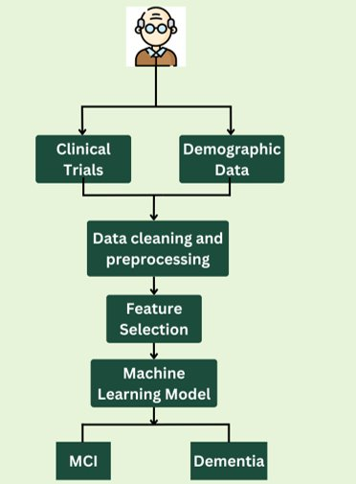
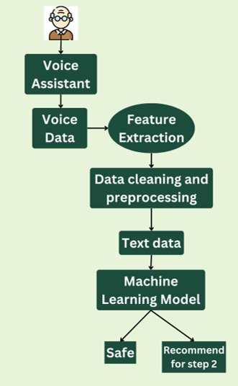
3 LAYER MODEL
FIRST LAYER – Early Detection
THIRD LAYER – Clinical Tests
SECOND LAYER - Questionnaire
THIRD LAYER – Clinical Tests
Audio patterns can serve as an early indicator of cognitive decline.
Utilizing audio conversations as a primary data source for early cognitive decline detection.
Implementation of the voice assistant is not included in the current scope but remains a potential avenue for future exploration.
Analyzing speech behavior, complexity, stutters, gaps, and more using Machine Learning models.
Recommendations for patients to undergo the second step of the method are based on the analysis of audio data.
The final step involves patients undergoing medical tests to assess their neuro-functionality and cognitive activity.
These medical tests provide crucial data on the patients' cognitive health.
The results of these tests plus the demographic data of the patients serve as inputs to a Machine Learning model.
The Machine Learning model utilizes these test results to predict whether the patient is currently afflicted by dementia or likely to develop dementia in the future.
The dataset used for training and testing the model is sourced from OASIS (open access series of imaging studies) longitudinal feature-set.
Most widely used test is MMSE (Mini-Mental State Examination).
But ceiling effect makes it insensitive to the early stage of dementia, specially for educated people.
And it is also have falsely identified low education or poor Cognitive decline as demented.
So we are going with ReSmart–15 questionnaire which initially consisted 35 question but was reduced to 15 because of redundant and low entropy questions and top 15 questions were selected based upon Information Gain.
The questionnaire consists of daily behavior-based questions in five categories (i.e., attention (3Q), spatial ability (3Q), spatiotemporal ability (3Q), memory (3Q), and thinking ability (3Q)).
which are inspired by CogniFit (Mobile App).
Another advantage of using ReSmart – 15 is MMSE requires hard classification results such as whether the patient had been diagnosed with early dementia or not while ReSmart-15 propose a probability of early dementia ranging (0 to 1), not with a hard decision of early dementia (0 or 1)

Slide 19
3 LAYER MODEL
FIRST LAYER – Early Detection
Audio patterns can serve as an early indicator of cognitive decline.
Utilizing audio conversations as a primary data source for early cognitive decline detection.
Implementation of the voice assistant is not included in the current scope but remains a potential avenue for future exploration.
Analyzing speech behavior, complexity, stutters, gaps, and more using Machine Learning models.
Recommendations for patients to undergo the second step of the method are based on the analysis of audio data.
THIRD LAYER – Clinical Tests
SECOND LAYER - Questionnaire
THIRD LAYER – Clinical Tests
The final step involves patients undergoing medical tests to assess their neuro-functionality and cognitive activity.
These medical tests provide crucial data on the patients' cognitive health.
The results of these tests plus the demographic data of the patients serve as inputs to a Machine Learning model.
The Machine Learning model utilizes these test results to predict whether the patient is currently afflicted by dementia or likely to develop dementia in the future.
The dataset used for training and testing the model is sourced from OASIS (open access series of imaging studies) longitudinal feature-set.
Most widely used test is MMSE (Mini-Mental State Examination).
But ceiling effect makes it insensitive to the early stage of dementia, specially for educated people.
And it is also have falsely identified low education or poor Cognitive decline as demented.
So we are going with ReSmart–15 questionnaire which initially consisted 35 question but was reduced to 15 because of redundant and low entropy questions and top 15 questions were selected based upon Information Gain.
The questionnaire consists of daily behavior-based questions in five categories (i.e., attention (3Q), spatial ability (3Q), spatiotemporal ability (3Q), memory (3Q), and thinking ability (3Q)).
which are inspired by CogniFit (Mobile App).
Another advantage of using ReSmart – 15 is MMSE requires hard classification results such as whether the patient had been diagnosed with early dementia or not while ReSmart-15 propose a probability of early dementia ranging (0 to 1), not with a hard decision of early dementia (0 or 1)

Slide 20
3 LAYER MODEL
SECOND LAYER - Questionnaire
Most widely used test is MMSE (Mini-Mental State Examination).
But ceiling effect makes it insensitive to the early stage of dementia, specially for educated people.
And it is also have falsely identified low education or poor Cognitive decline as demented.
So we are going with ReSmart–15 questionnaire which initially consisted 35 question but was reduced to 15 because of redundant and low entropy questions and top 15 questions were selected based upon Information Gain.
The questionnaire consists of daily behavior-based questions in five categories (i.e., attention (3Q), spatial ability (3Q), spatiotemporal ability (3Q), memory (3Q), and thinking ability (3Q)).
which are inspired by CogniFit (Mobile App).
Another advantage of using ReSmart – 15 is MMSE requires hard classification results such as whether the patient had been diagnosed with early dementia or not while ReSmart-15 propose a probability of early dementia ranging (0 to 1), not with a hard decision of early dementia (0 or 1)
FIRST LAYER – Early Detection
THIRD LAYER – Clinical Tests
THIRD LAYER – Clinical Tests
Audio patterns can serve as an early indicator of cognitive decline.
Utilizing audio conversations as a primary data source for early cognitive decline detection.
Implementation of the voice assistant is not included in the current scope but remains a potential avenue for future exploration.
Analyzing speech behavior, complexity, stutters, gaps, and more using Machine Learning models.
Recommendations for patients to undergo the second step of the method are based on the analysis of audio data.
The final step involves patients undergoing medical tests to assess their neuro-functionality and cognitive activity.
These medical tests provide crucial data on the patients' cognitive health.
The results of these tests plus the demographic data of the patients serve as inputs to a Machine Learning model.
The Machine Learning model utilizes these test results to predict whether the patient is currently afflicted by dementia or likely to develop dementia in the future.
The dataset used for training and testing the model is sourced from OASIS (open access series of imaging studies) longitudinal feature-set.

Slide 21
3 LAYER MODEL
THIRD LAYER – Clinical Tests
THIRD LAYER – Clinical Tests
The final step involves patients undergoing medical tests to assess their neuro-functionality and cognitive activity.
These medical tests provide crucial data on the patients' cognitive health.
The results of these tests plus the demographic data of the patients serve as inputs to a Machine Learning model.
The Machine Learning model utilizes these test results to predict whether the patient is currently afflicted by dementia or likely to develop dementia in the future.
The dataset used for training and testing the model is sourced from OASIS (open access series of imaging studies) longitudinal feature-set.
FIRST LAYER – Early Detection
SECOND LAYER - Questionnaire
Audio patterns can serve as an early indicator of cognitive decline.
Utilizing audio conversations as a primary data source for early cognitive decline detection.
Implementation of the voice assistant is not included in the current scope but remains a potential avenue for future exploration.
Analyzing speech behavior, complexity, stutters, gaps, and more using Machine Learning models.
Recommendations for patients to undergo the second step of the method are based on the analysis of audio data.
Most widely used test is MMSE (Mini-Mental State Examination).
But ceiling effect makes it insensitive to the early stage of dementia, specially for educated people.
And it is also have falsely identified low education or poor Cognitive decline as demented.
So we are going with ReSmart–15 questionnaire which initially consisted 35 question but was reduced to 15 because of redundant and low entropy questions and top 15 questions were selected based upon Information Gain.
The questionnaire consists of daily behavior-based questions in five categories (i.e., attention (3Q), spatial ability (3Q), spatiotemporal ability (3Q), memory (3Q), and thinking ability (3Q)).
which are inspired by CogniFit (Mobile App).
Another advantage of using ReSmart – 15 is MMSE requires hard classification results such as whether the patient had been diagnosed with early dementia or not while ReSmart-15 propose a probability of early dementia ranging (0 to 1), not with a hard decision of early dementia (0 or 1)

Slide 22
THIRD LAYER – Clinical Tests
GOOGLE COLAB LINKS
Phase 1
Phase 3

Slide 23
RESULTS
RESULTS
RESULTS
RESULTS
RESULTS

Slide 24
RESULTS
RESULTS
RESULTS
RESULTS
RESULTS

Slide 25
RESULT
Early detection of cognitive decline is essential for timely intervention.
The three-step method offers a balanced approach, combining audio analysis, cognitive assessment, and medical tests.
The SVM model showed strong predictive performance in both Step 1 and Step 3.
Cognitive decline detection can be made more cost-effective by filtering out low-risk patients in the initial steps.
The approach emphasizes patient-centered care and the importance of early intervention in dementia management.

Slide 26
CONCLUSION & FUTURE
CONCLUSION & FUTURE
CONCLUSION & FUTURE
CONCLUSION & FUTURE
CONCLUSION & FUTURE

Slide 27
CONCLUSION & FUTURE
CONCLUSION & FUTURE
CONCLUSION & FUTURE
CONCLUSION & FUTURE
CONCLUSION & FUTURE

Slide 28
CONCLUSION
Research focus: Addressing critical concerns in dementia diagnosis, particularly timing and financial burdens.
Emphasis on early detection: Utilizing a three-step method involving non-invasive audio analysis and questionnaires.
Optimization of resources: Filtering out low-risk patients to optimize healthcare resources effectively.
Balancing early detection and accuracy: Striking a balance between prompt identification and precise diagnosis.
Immediate stress reduction: Providing structured dementia assessment to minimize immediate stress on patients and families.

Slide 29
FUTURE SCOPE
Advancing Diagnostics with MRI Integration
Enabling Personalized Interventions through Wearable Devices
Elevating Accuracy with Enhanced Machine Learning Algorithms
Building Trust via Transparent AI Decision-Making
Collaborative Data Insights for Comprehensive Understanding

Slide 30
REFERENCES
REFERENCES
REFERENCES
REFERENCES
REFERENCES

Slide 31
REFERENCES
REFERENCES
REFERENCES
REFERENCES
REFERENCES

Slide 32
Published | Title | AUTHOR
JUN 2017 | “Early Diagnosis of Dementia from Clinical Data by Machine Learning Techniques” | So A, Hooshyar D, Park KW, Lim HS.
DEC 2021 | “Performance of Machine Learning Algorithms for Predicting Progression to Dementia in Memory Clinic Patients” | James C, Ranson JM, Everson R, Llewellyn DJ
MAR 2022 | “Machine Learning for Dementia Prediction: A Systematic Review and Future Research Directions” | Cui Y, Liu B, Luo S
JULY 2022 | ReSmart-15: A Soft Information Gain Based Questionnaire for Early Dementia Detection | Hyeseong Park1, Myung Won Raymond Jung1, Ji-Hye Kim2 and Uran Oh3*

Slide 33
THANK YOU!

